Slide 1
FUTURE MODELS
23/01/2019
Albert Burgers
4117433

Slide 2
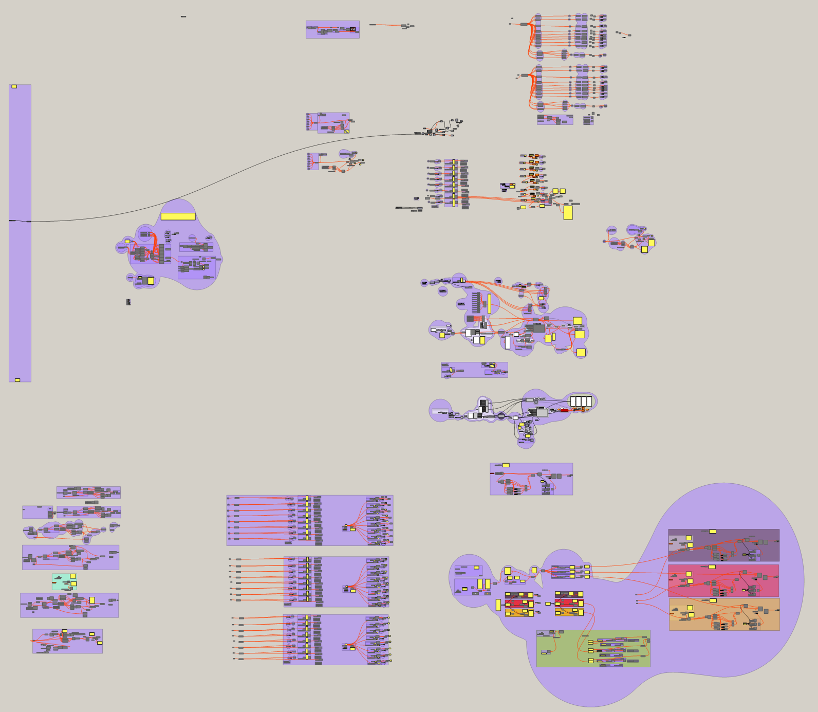

Slide 3
2. Density
Study
1. Layout
Scripts
3. Diversity
Script
5. Filip’s
Script
3. Voxelized
Script
4. Voxelized Tool
Job’s Script

Slide 4
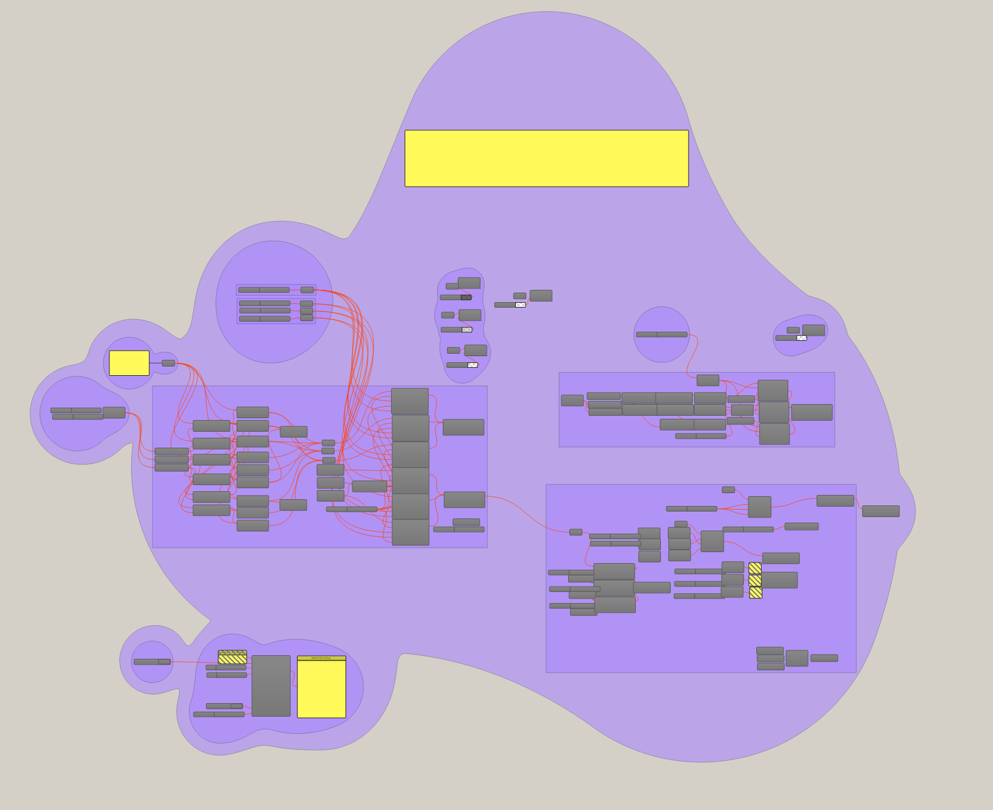
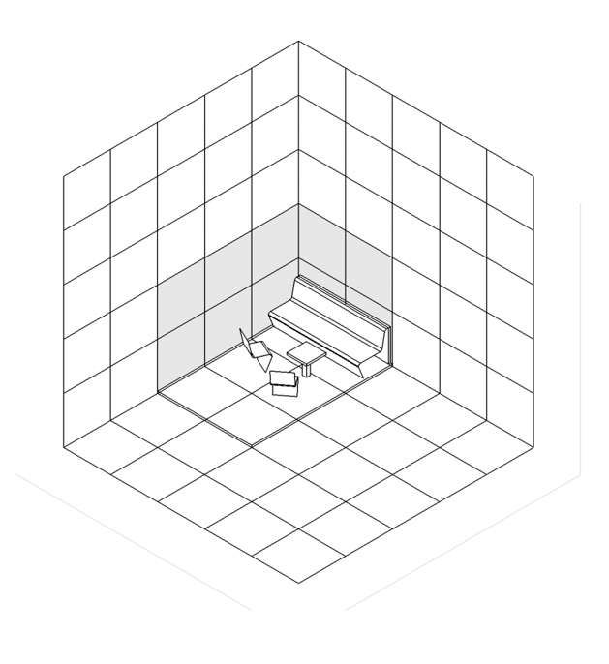
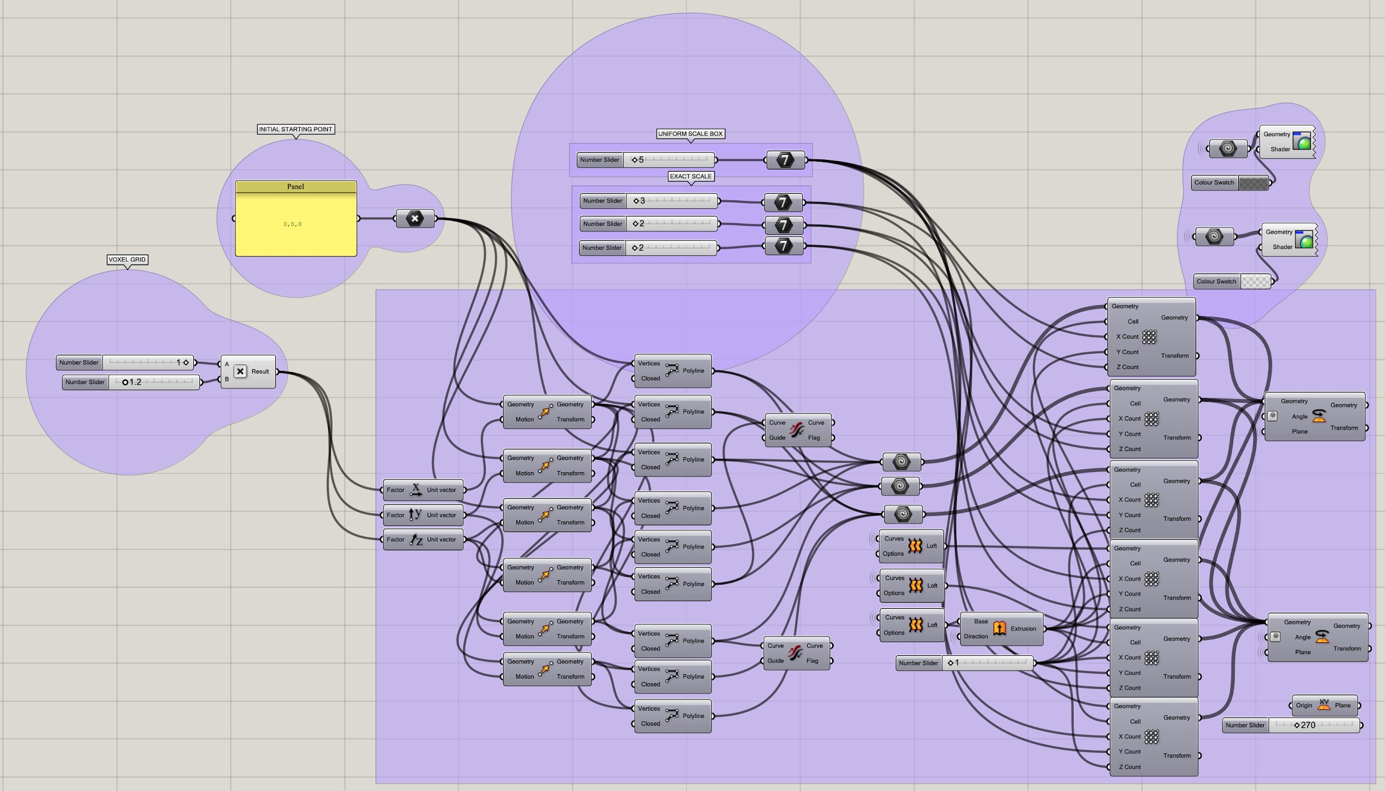
1. Layout Script:
> Use of screen capture to to take identical axonometric shots.
> Point based grid, which expands according to the pod size. Surface’s get highlighted if used by the pod.

Slide 5
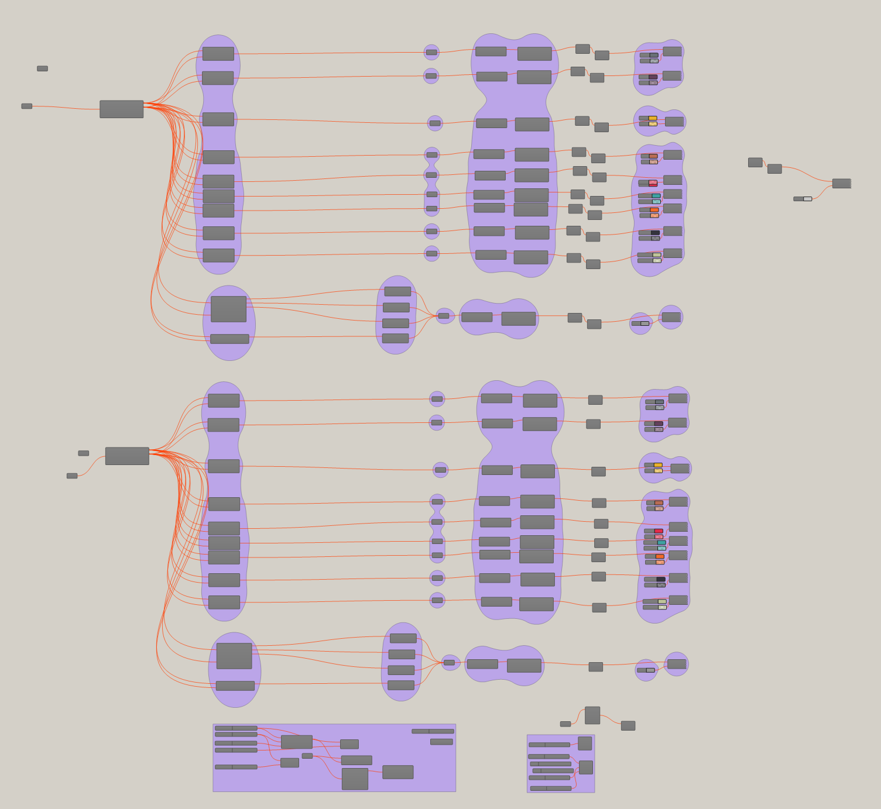
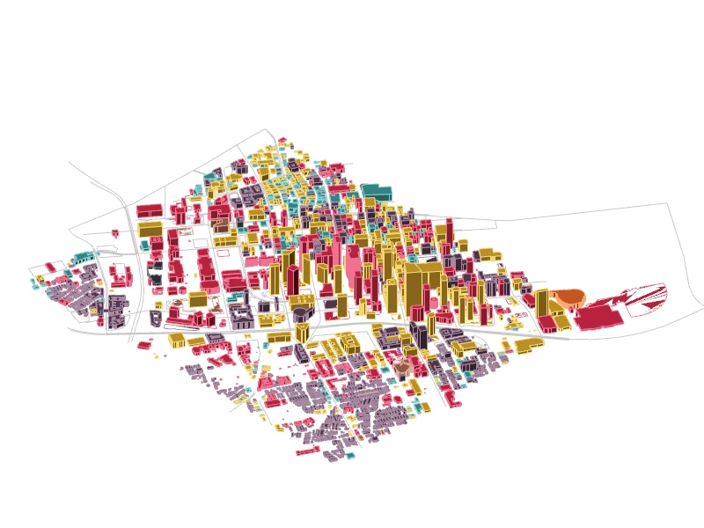
2. Density study:
> Use of Elk tool to quantify an area in Los Angeles.

Slide 6
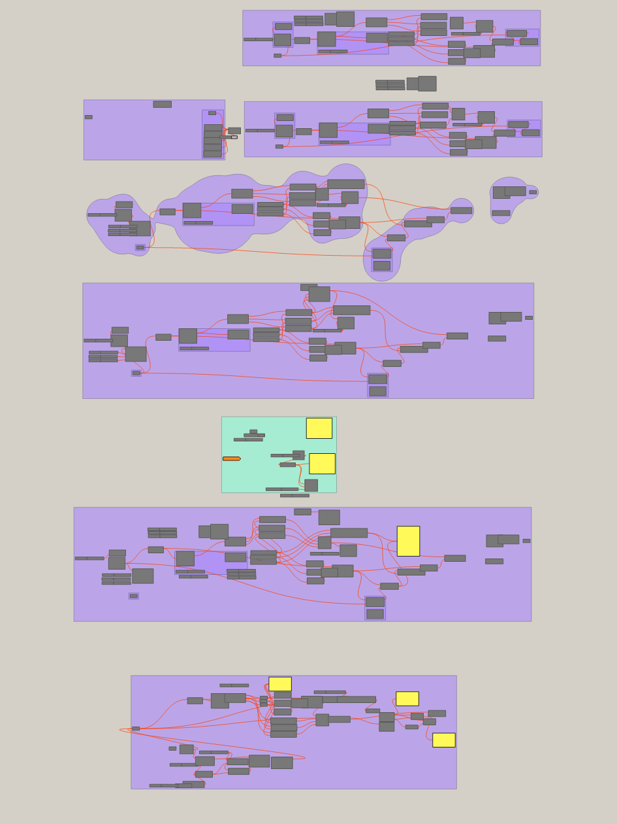
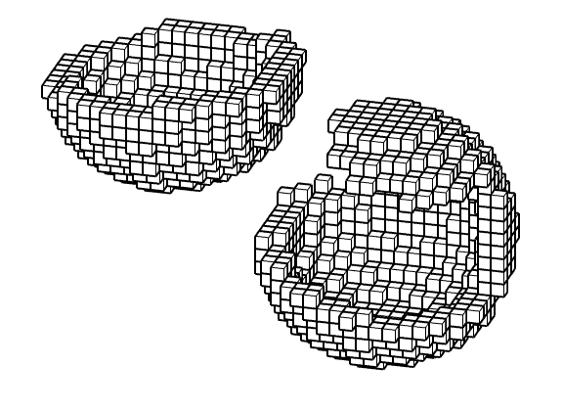
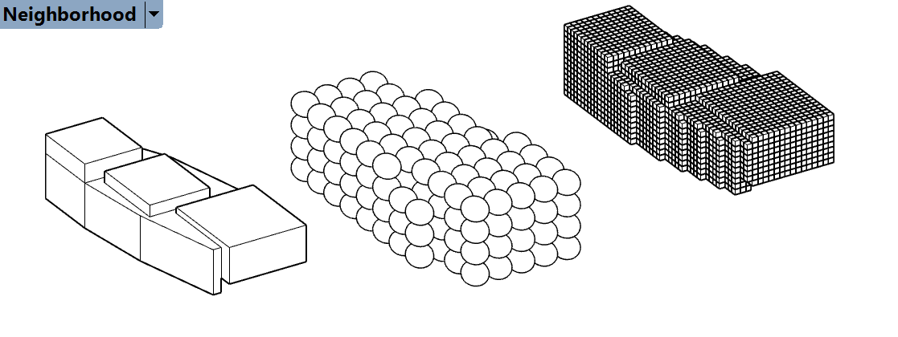
3. Voxelized script:
> Point based grid determined by bounding box that populates the volume randomly.
> Initial study into voxelization.

Slide 7
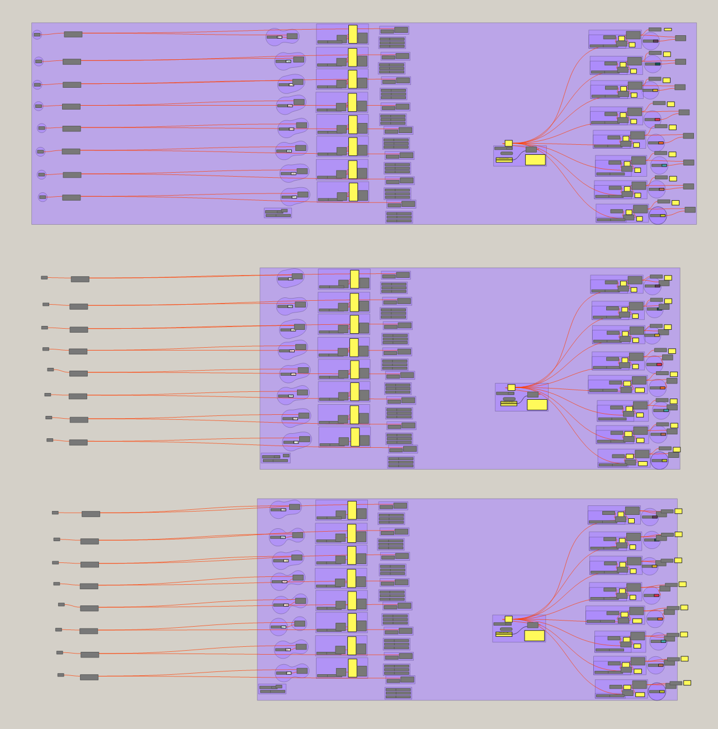
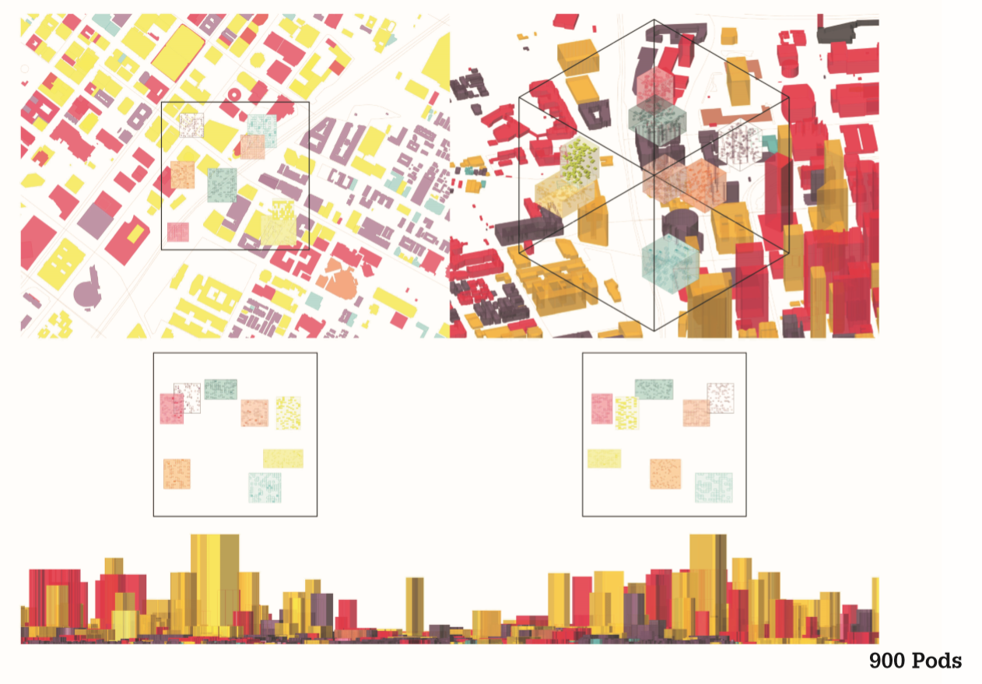
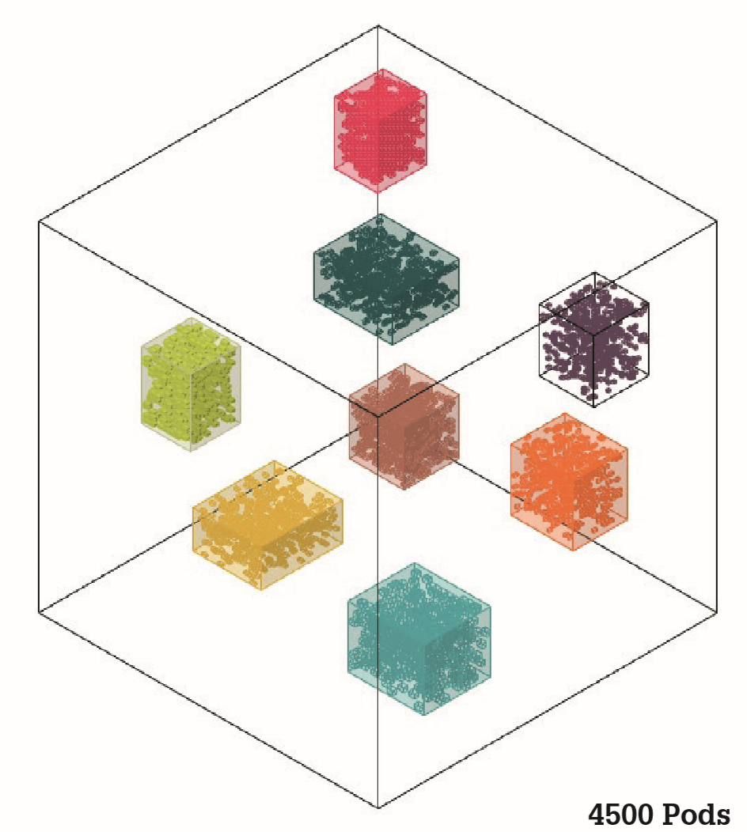
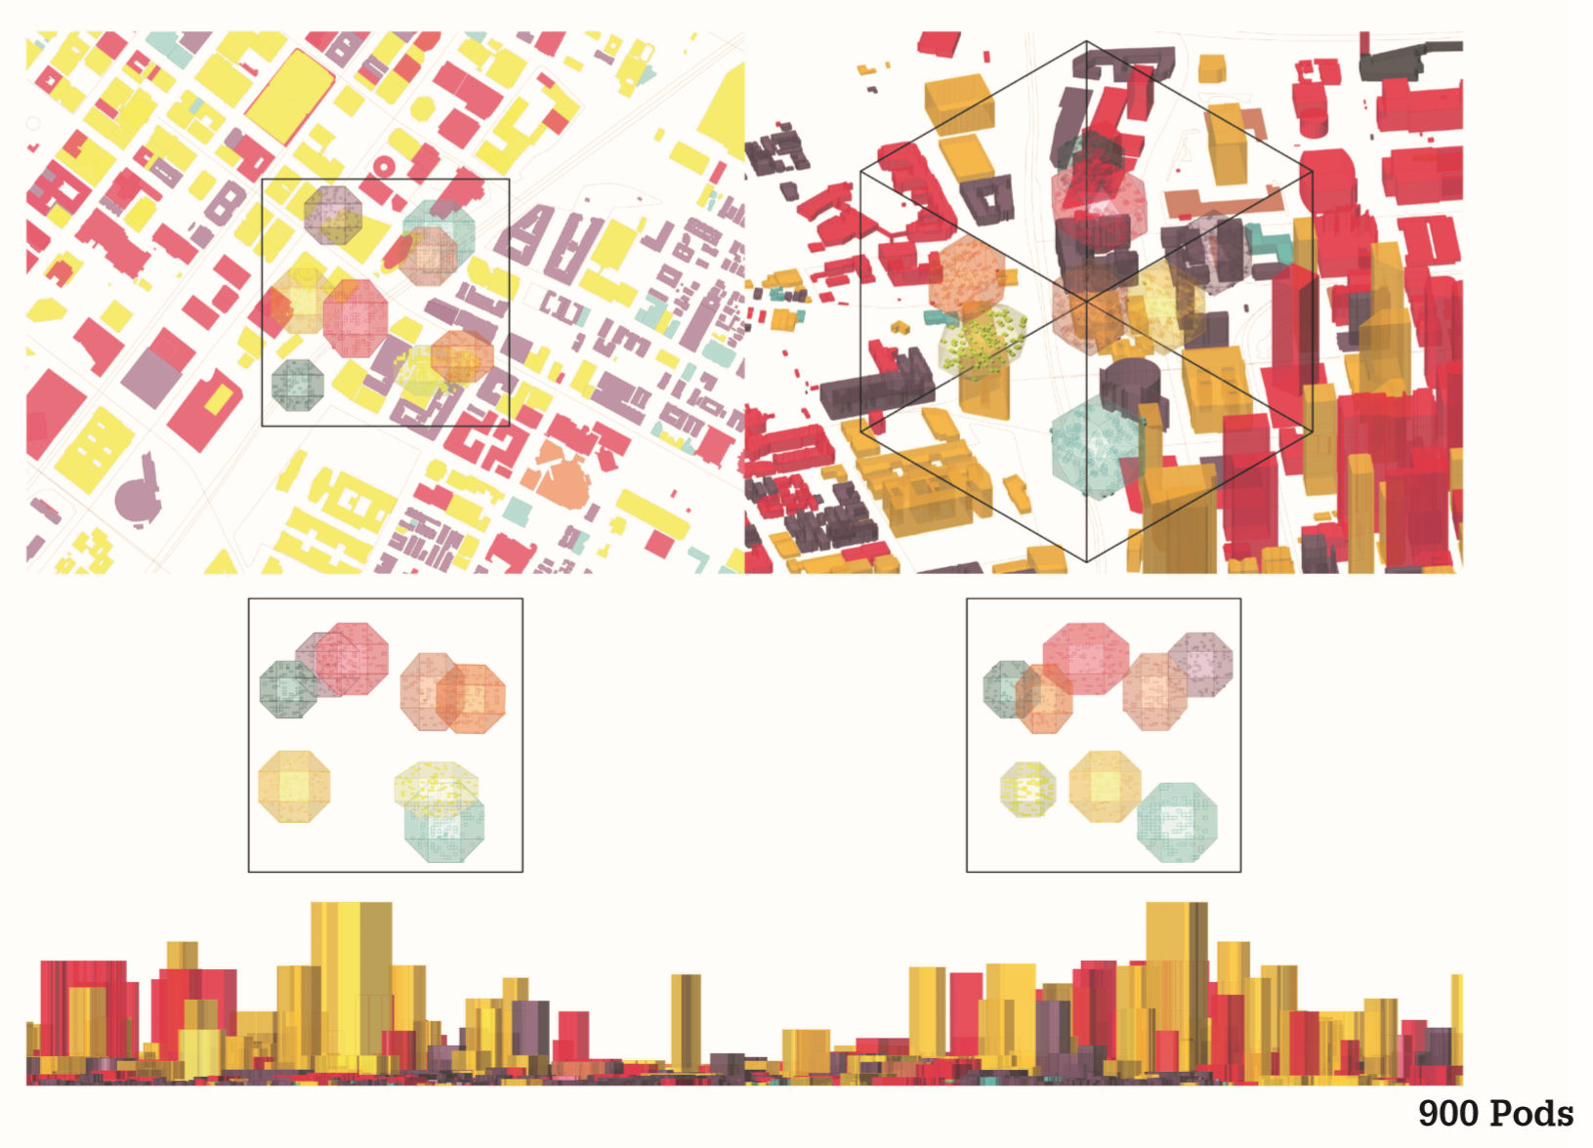
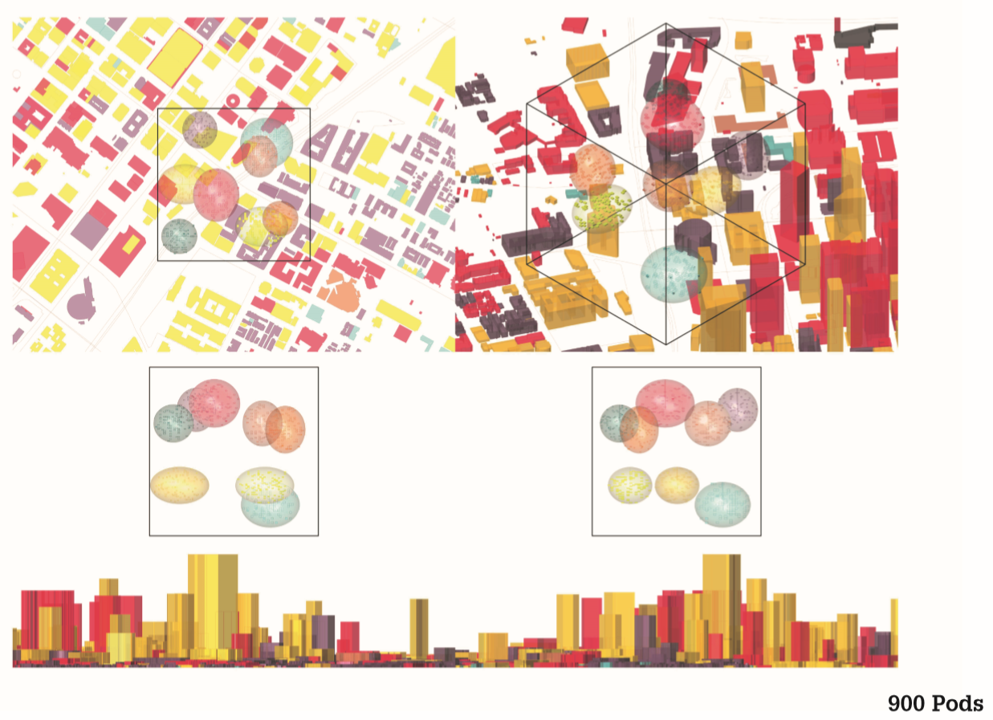
4. Voxelized tool:
> Tool which has scripted the before mentioned voxelization.
> Study into amount of pods that could fit inside the cube.

Slide 8


Slide 9
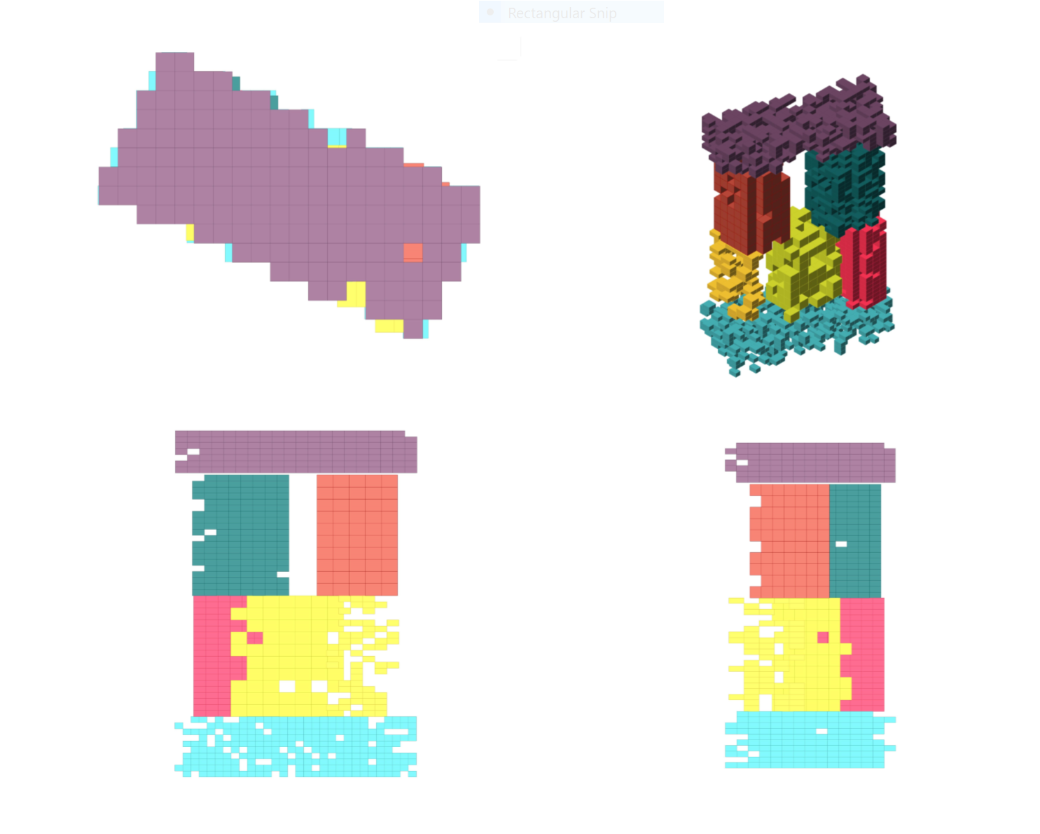

Slide 14
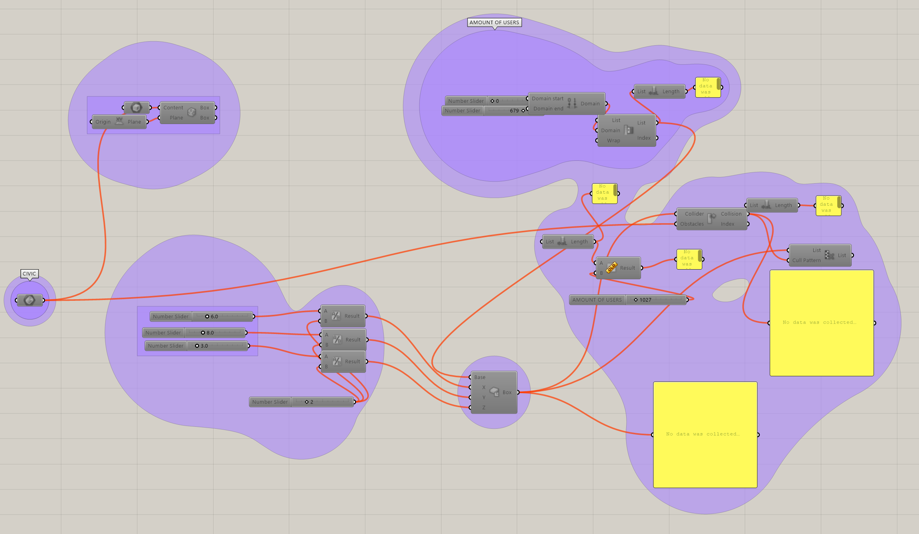
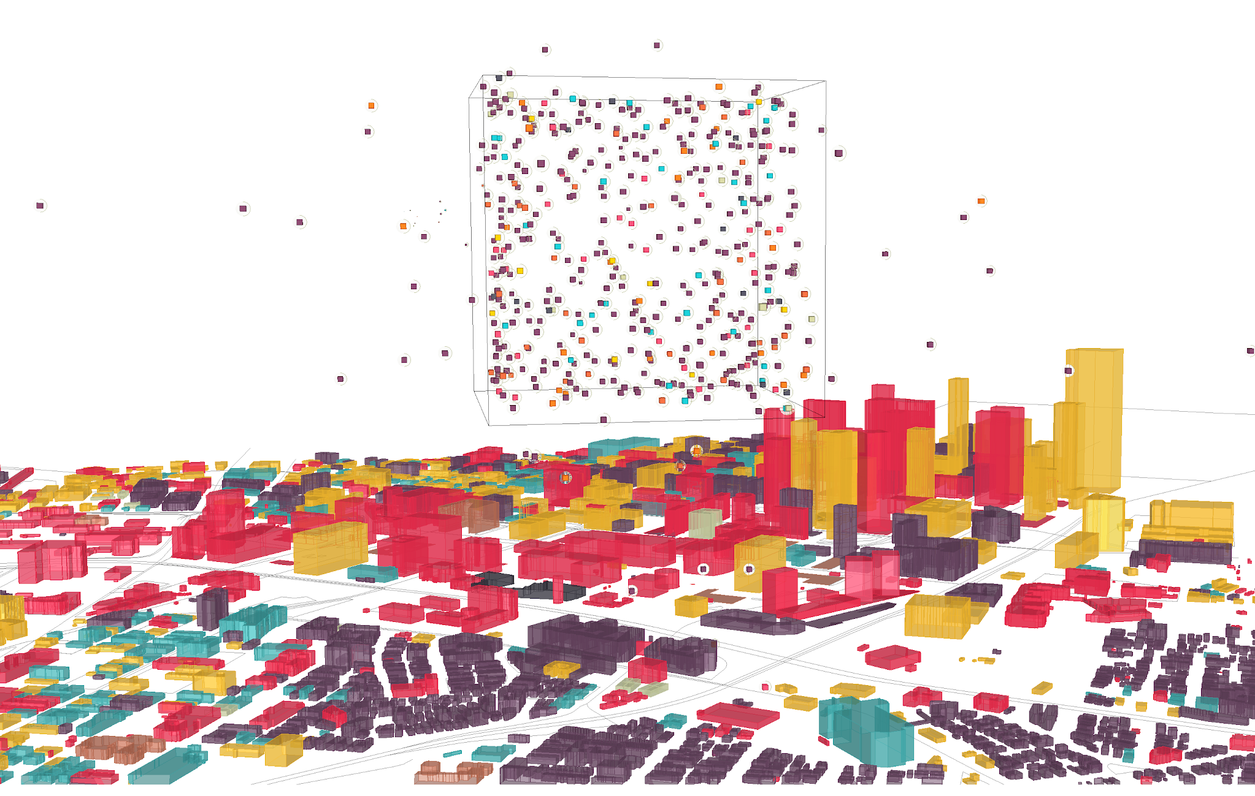
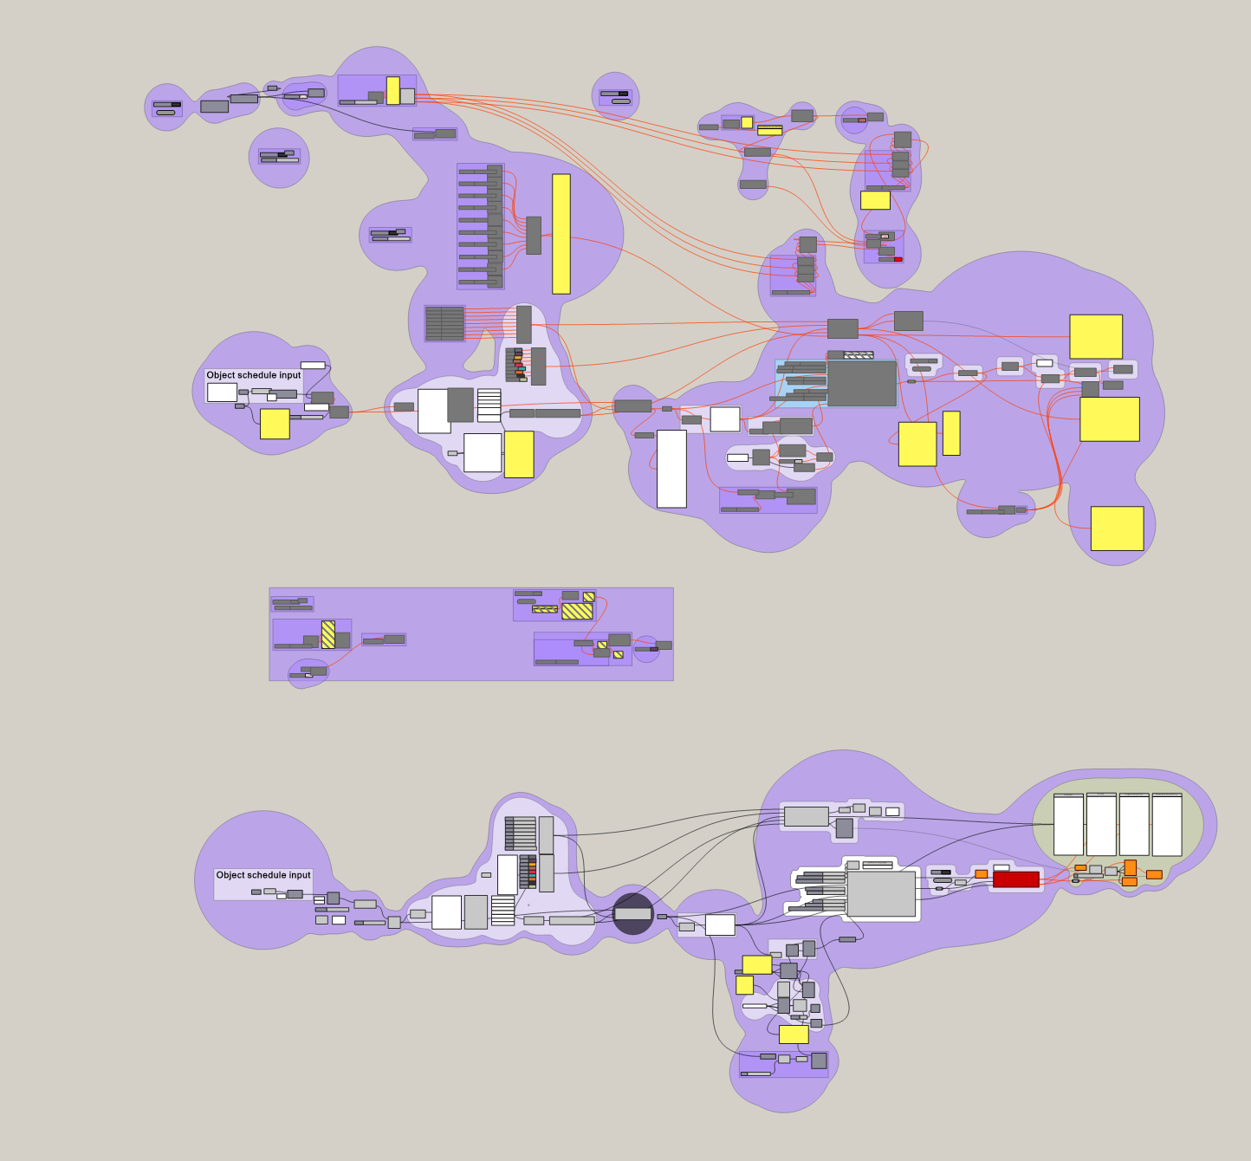
5. Flow Integration:
> Point list where identified, amount of pods quantified. But not enough time.

Slide 15
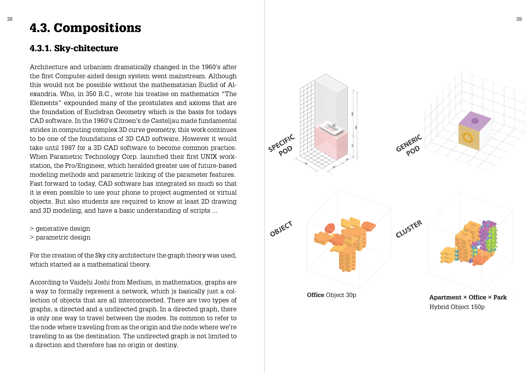
6. Text Object Simulation:
> History of CAD
> Discrete Mathematics
> Graph theory
> Automata theory
> Generative design
TEXT UPLOADED
AS PDF

